Slide 1
Repetition Structures

Slide 2
The Increment and Decrement Operators
++ is the increment operator : It adds one to a variable.
val++; is the same as val = val + 1;
++ can be used before (prefix) or after (postfix) a variable:
++val; val++;

Slide 3
The Increment and Decrement Operators
-- is the decrement operator : It subtracts one from a variable.
Val--; is the same as val = val - 1;
-- can be used before (prefix) or after (postfix) a variable:
--val; val--;

Slide 4
Prefix vs. Postfix
++ and -- operators can be used in complex statements and expressions
In prefix mode (++val, --val) the operator increments or decrements, then returns the value of the variable
In postfix mode (val++, val--) the operator returns the value of the variable, then increments or decrements

Slide 5
Prefix vs. Postfix-Examples
int num, val=10
Display val++ // displays 10
// val is now 11
Display ++val // sets val to 12, then displays it
num= --val // sets val to 11,
// stores 11 in num
num= val-- // stores 11 in num,
// sets val to 10

Slide 6
Introduction to Loops: The while Loop
Loop: a control structure that causes a statement or statements to repeat
General format of the while loop:
while (expression)
statement;
statement; can also be a block of statements enclosed in { }

Slide 7
While Loop - How it works
while (expression)
statement;
expression is evaluated
– if true, then statement is executed, and expression is evaluated again
– if false, then the loop is finished and program statements following statement execute

Slide 8
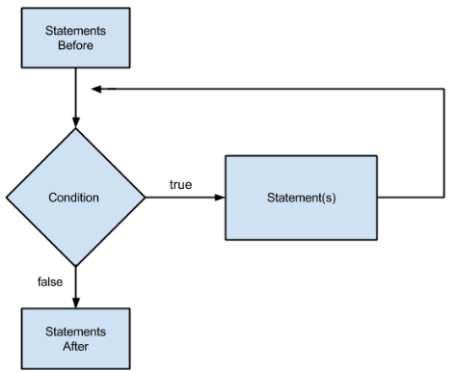
The logic of a while Loop

Slide 9
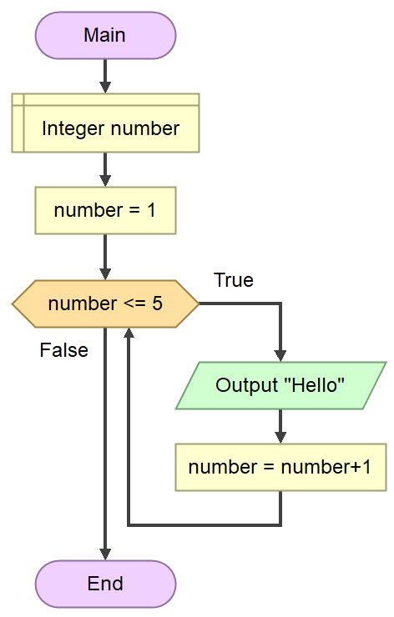
While Loop-example
Step1. Start
Step2. Declare number
Step 3 number=1
Step4. loop while (number <=5)
Display “Hello”
number=number+1
end while
Step5. End
Test this expression
If the expression Is true,
perform these statements

Slide 10
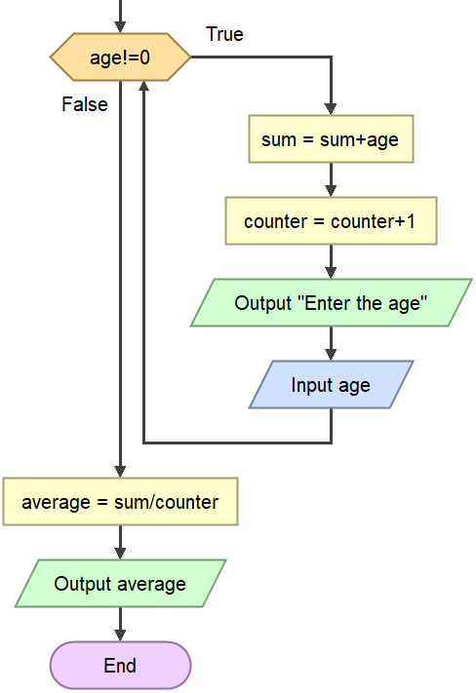
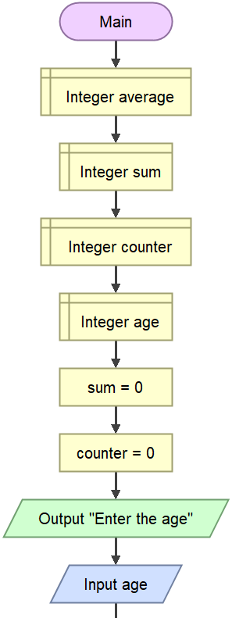
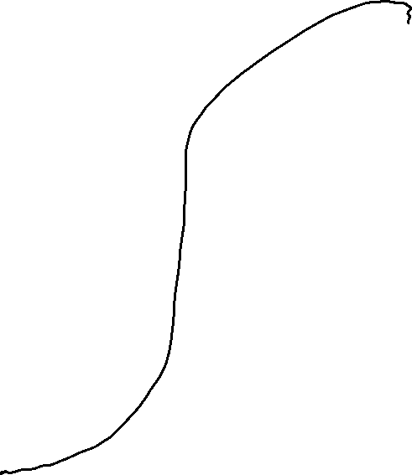
Example: Average Age of a Class — While/WhileEnd

Slide 11
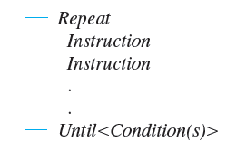
Repeat/Until Algorithm Format Posttest Looping (Do-While Loop)

Slide 12
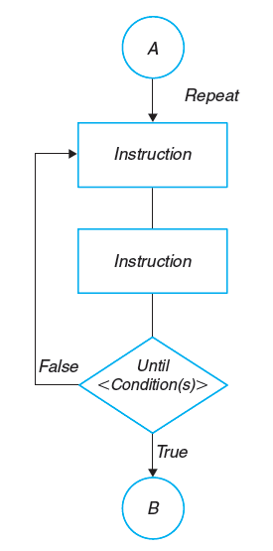
Flowchart Diagram of Repeat/Until

Slide 13
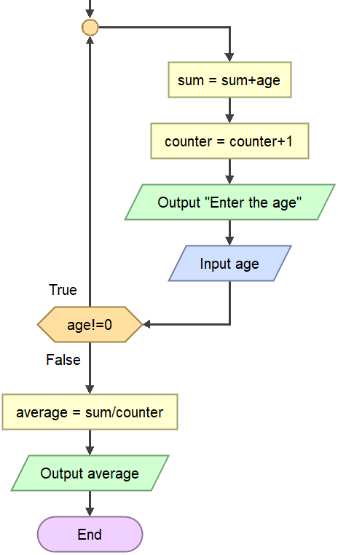
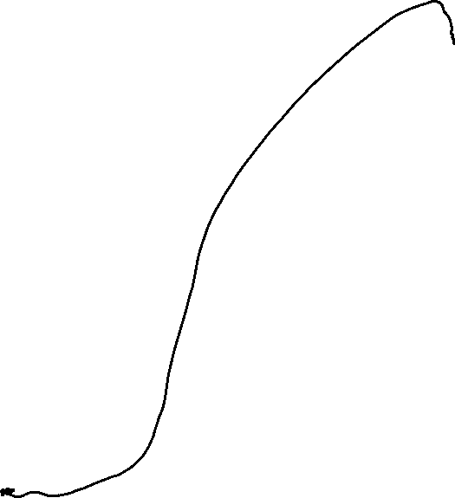
Average Age of a Class — Repeat/Until

Slide 14
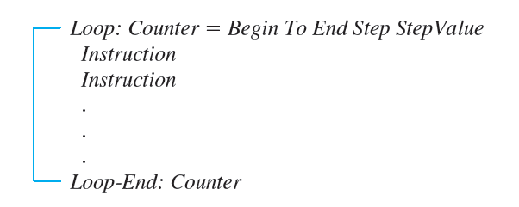
Automatic Counter Loop Format Pretest Looping (For / Counter Loop)

Slide 15
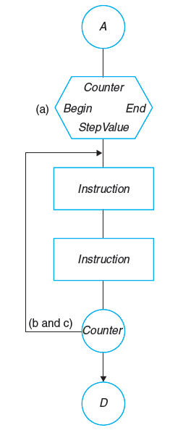
Flowchart of Automatic-Counter Loop

Slide 16
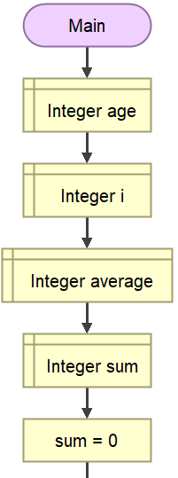
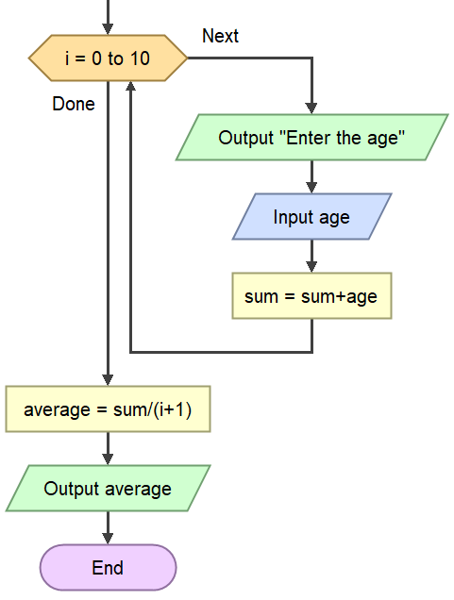
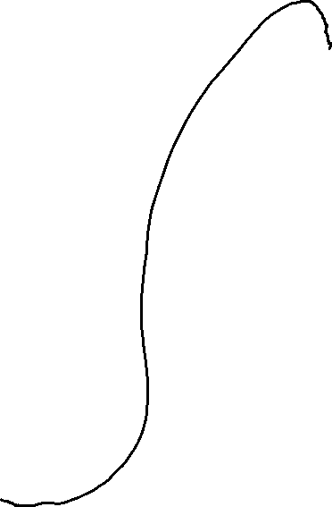
Example of an Algorithm and Flowchart for a Problem Using an Automatic-Counter Loop

Slide 17
Exercice 6.1
Writhe the pseudocode and draw the flowchart to find the sum of the first n positive integers.

Slide 18
Exercice 6.2
Writhe the pseudocode and draw the flowchart to print the integer numbers from 1 to 10 and its square.

Slide 19
Exercice 6.3
Writhe the pseudocode and draw the flowchart to Print the following series:
0 5 10 15 20 25 ………… 100

Slide 20
Exercice 6.4
Write a Pseudocode and draw flowchart to keep asking for a number until a negative number is entered. At the end, print the sum of the odd numbers entered by the user.
For example:
Numbers entered by the user: 7, 6, 2, 3
Output: the sum of the odd entered number is: 10

